Slide 1



ICSAT 2010
Approach for the solution of a simplified Reissner Theory of elastic Plates
- Application in the automotive industry-

Slide 2

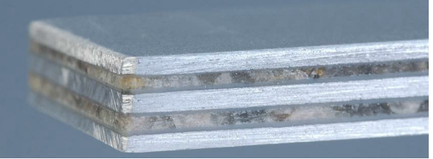
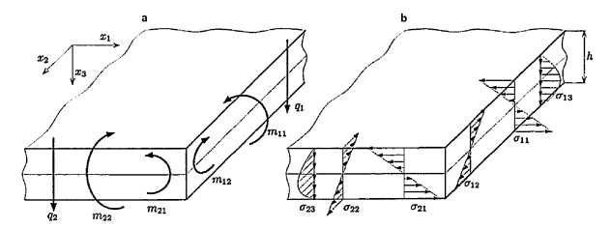
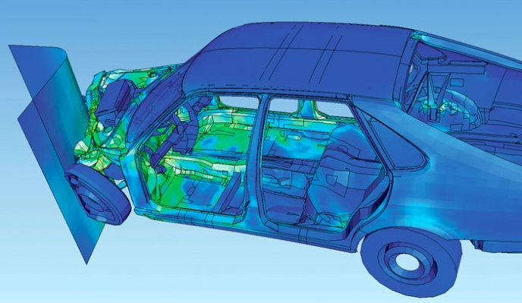
Introduction
Reissner Plate
Solution Approaches
Fazit and Prospects
Motivation
Reissner Theory:
Benefits of modern Plate-Theories:
More accurate stress and deformations analysis
New Elements in FEM (shape functions )
Weight reduced, optimized structures
Sustainability

Slide 3
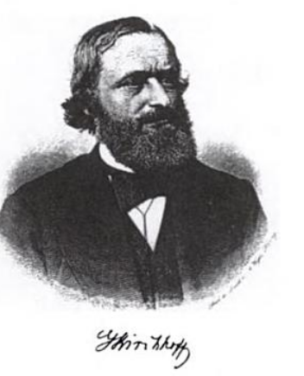

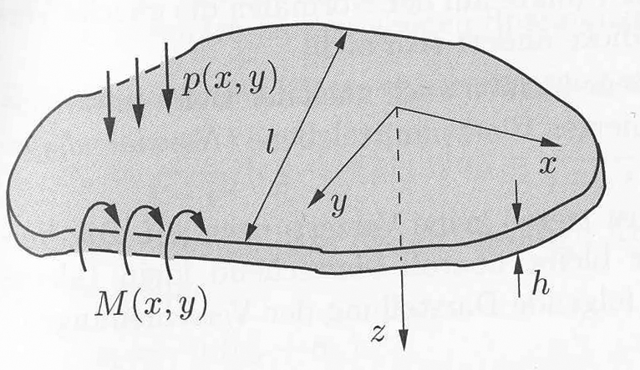
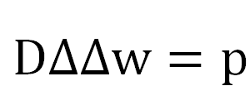
Introduction
Reissner Plate
Solution Approaches
Fazit and Prospects
Classic plate theory
Kirchhoff`s Theory:
4th order differential equation based on Kirchhoff`s assumption
Solution well-known (e.g. FE-Solvers)
practical and fast solution
Scope:
- Very thin plates, stiff plates
- Transverse shear rigid plates

Slide 4

Introduction
Reissner Plate
Solution Approaches
Fazit and Prospects
Innovative materials
Laminates, sandwich materials etc.
Characteristics like:
Thicker plates
relatively soft interlaminar shear modulus
Problems:
Kinematic Hypothesis based on Bernoulli/Kirchhoff is not adequate
Imperfection on the boundaries
High Safety Factor → Oversized Constructions

Slide 5
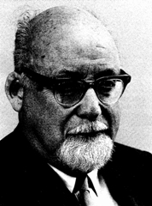
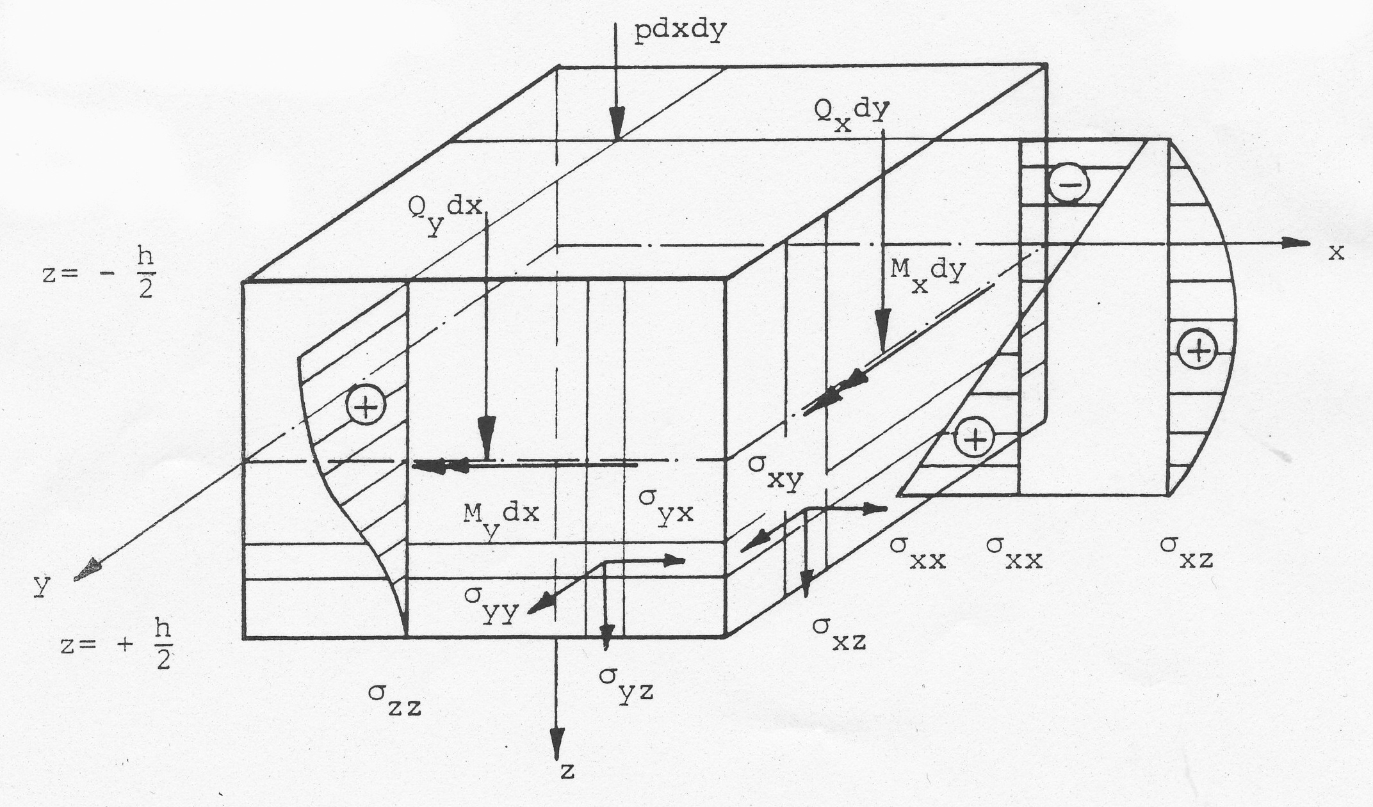
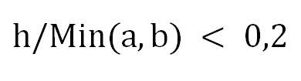
Introduction
Solution Approaches
Fazit and Prospects
Reissner Theory
Modern plate theory of Reissner
Key points:
1. Hypothesis of stress distribution:
Stress in plane is identically to the Kirchhoffs Theory
Transverse shear stress
Normal transverse stress
Three dimensional state of stress

Slide 6
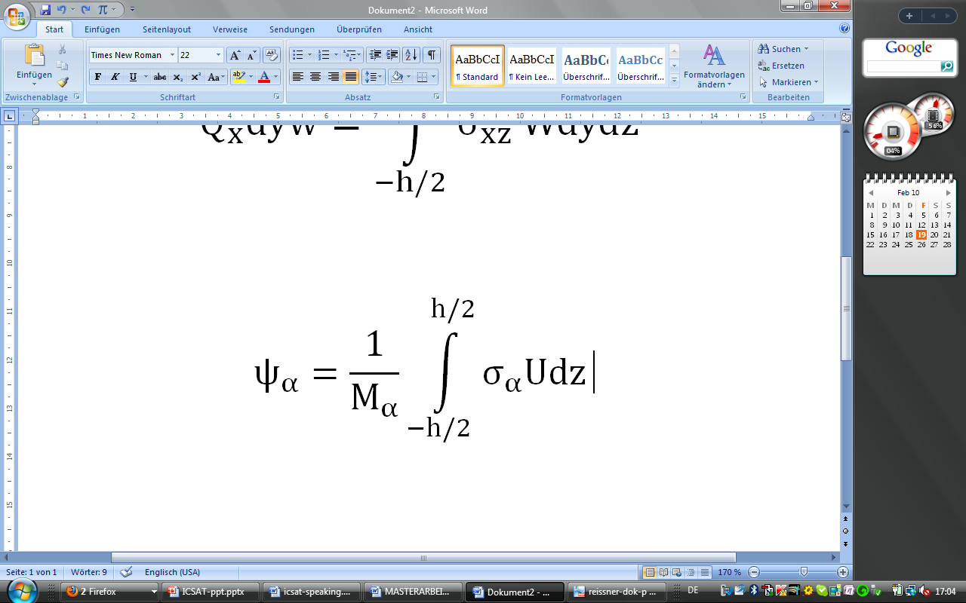
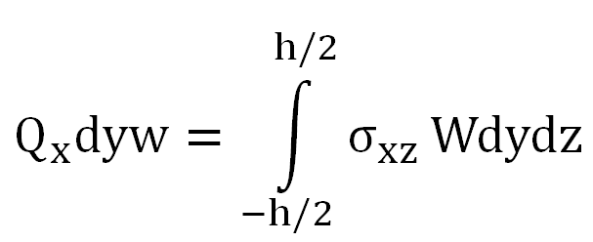
Introduction
Solution Approaches
Fazit and Prospects
Reissner Theory
Modern plate theory of Reissner
2. Virtual Work Principal:
Deflection w
Two averaged rotations (normal to the mid-plane of plate)
Defining resultant strain quantities (fictitious)
Basic assumptions
Geometrically linear: small strains, small displacements (Theory of first order) Constitutive linear elastic equation (Hooke’s law) | Isotropic/orthotropic Materials behavior Rectangle coordinates for polygon plates

Slide 7
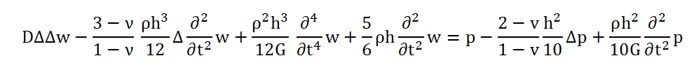
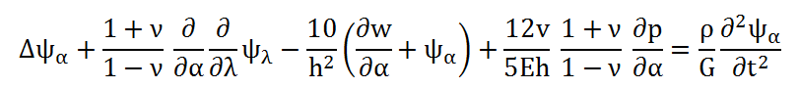
Introduction
Solution Approaches
Fazit and Prospects
Reissner Theory
The dynamic governing equations
Systems of three inhomogeneous, transient, linear , partial, coupled Differential Equations of 6th order with constant coefficients
12 Constant of Integration→ three independent boundary conditions
The first Reissner differential equation
The second and third Reissner differential equation
Problem: No solution yet

Slide 8
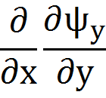
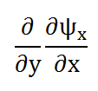


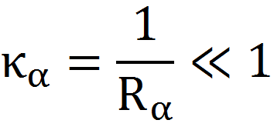
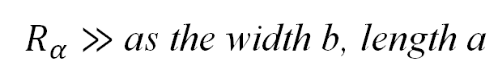
Introduction
Fazit and Prospects
Reissner Theory
Solution Approaches
Introduction of hypothesis
Assumption:
A very small imperfection of the elastic plate (Gauss curvature )
Coupling-Term
Uncoupling Solution possible with common methods

Slide 9
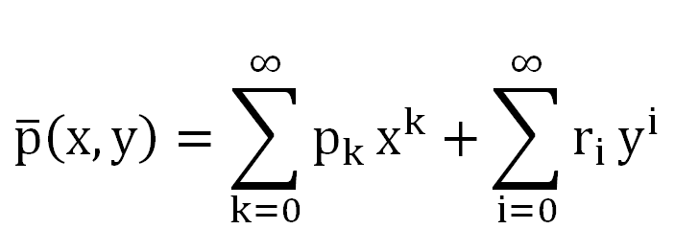
Introduction
Fazit and Prospects
Reissner Theory
Solution Approaches
Load type specification
Distributed Load:
Polynomial function:
Symmetrical or non symmetrical pressure for rectangle plates
(time invariant and no smoothing terms)

Slide 10

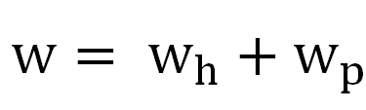
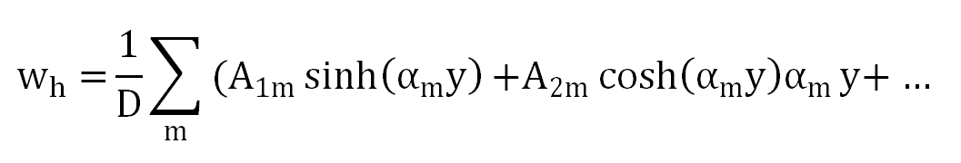
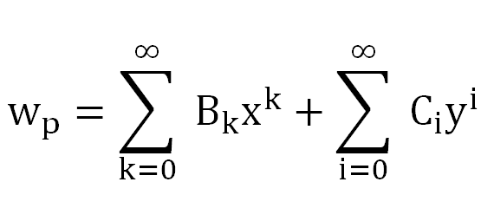
Introduction
Fazit and Prospects
Reissner Theory
Solution Approaches
Analytical solution: static problem
First Reissner differential equation:
Superposition
Homogeneous Solution:
Identical to Kirchhoff Theory
Particular Integral: Comparison of Coefficients
4th order: 8 free constant for adjustments on the boundaries

Slide 11
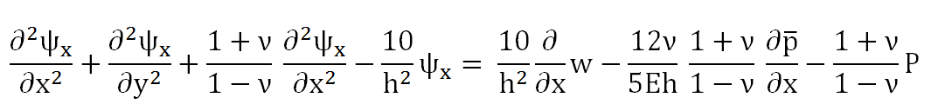
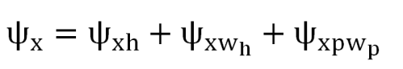
Introduction
Fazit and Prospects
Reissner Theory
Solution Approaches
Analytical solution: static problem
Second Reissner differential equation (Analogous for the third equations):
Superposition:
2nd order: Homogeneous solution provides four constants of integration
Uncoupling General Solutions consist of 16 constant of Integration
…well known, analytical Functions: superposition’s of hyperbolic and trigonometric terms, power series approach and recursive formulas
11
11

Slide 12
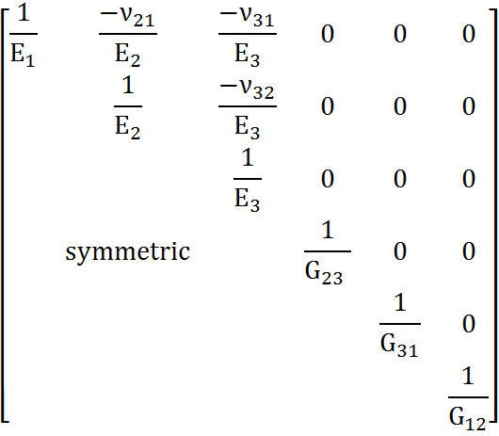
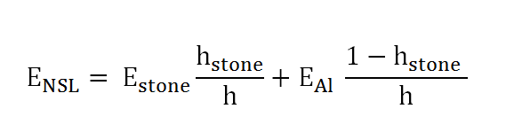
Introduction
Fazit and Prospects
Reissner Theory
Solution Approaches
Natural Stone Laminate
.
- A directionally dependent , inhomogeneous Composite:
Orthotropic Material
Derivation of transversal isotropic Reissner Equations
→ The difference is assumed to be neglectable
Homogenization

Slide 13
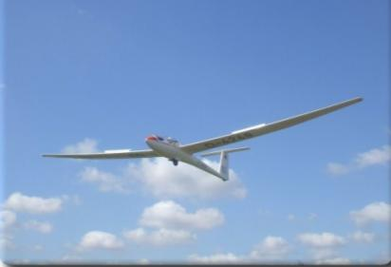
Introduction
Reissner Theory
Solution Approaches
Prospects
Prospect
Parameter study: Effects of the assumptions
Investigation on Hooks Law and Homogenization
Validity
Conclusion
Modified Reissner equations
Integrals for three differential equation could be derivate separately
Enough Variables for adjustments on the boundary
Higher degree of accuracy in stress analysis → Weight reduced, optimized Structures
13

